Slide 1
Paris house pricing prediction
A machine learning project
Researched and concluded by:
Daisy
Wakhungu

Slide 2
Table of content
Problem statement definition
Methodology
Findings
Visualizations
Actual vs predicted prices
Conclusion
End page

Slide 3
Problem statement definition
The problem statement to this project is to make house pricing predictions using data obtained from Kaggle site

Slide 4
methodology
Download and load the dataset. After downloading, load the dataset into a Pandas DataFrame using the read_csv() function.
Explore and clean the dataset: Use the head(), info(), and describe() functions to explore the dataset and identify any missing or inconsistent data. Clean the dataset by removing any duplicates, irrelevant or redundant features, and filling in missing values if necessary.
Split the dataset into training and testing sets: Use the train_test_split() function from scikit-learn to split the dataset into training and testing sets.r)
5.Train and evaluate the model: Train the model using a regression algorithm such as Linear Regression or Random Forest Regression. Evaluate the model's performance using the mean squared error (MSE) and R-squared score.
Make predictions: Use the trained model to make predictions on new data.
Preprocess the data: Preprocess the data by scaling the features using the StandardScaler() function from scikit-learn

Slide 5
Model Findings
The data has 17 columns and Range Index: 10000 entries, 0 to 9999
According to the correlation matrix, “squreMeters”and “noOfRooms”have a weak positive correlation (0.009573), which means that as the size of a property (measured in square meters) increases, the number of rooms may also increase slightly. On the other hand, and have a weak negative correlation (-0.017246), which means that as the size of a property increases, the number of garages may decrease slightly.
The Linear Regression model has a mean squared error (MSE) of 3482280.93 and an R-squared value of 0.999999566. The R-squared value is a measure of how well the model fits the data, with a value of 1 indicating a perfect fit. In this case, the Linear Regression model has a very high R-squared value, which suggests that the model is an excellent fit for the data.
The Random Forest Regression model has a higher MSE of 15756626.96, indicating that its predictions are further from the true values than the Linear Regression model. However, the Random Forest Regression model still has a very high R-squared value of 0.99999804, which suggests that it is also a good fit for the data.
the Linear Regression model may be a slightly better fit for the data than the Random Forest Regression model.

Slide 6
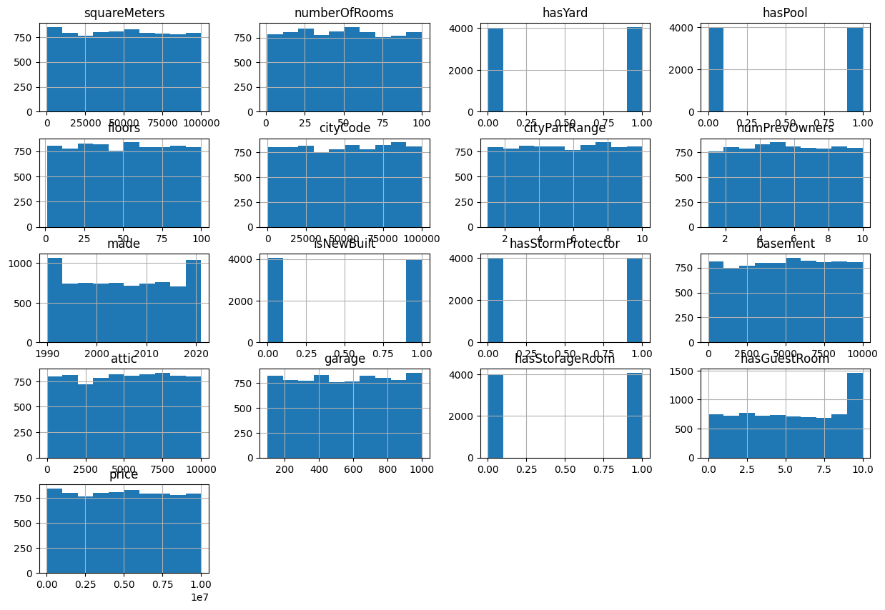
Visualizations
a.)Skewness

Slide 7
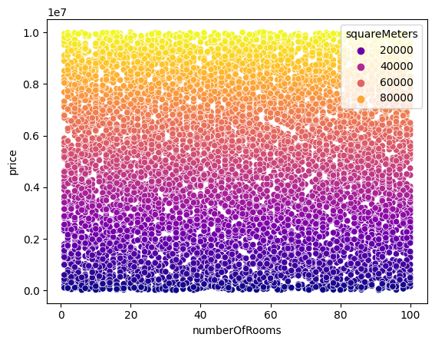
b.)scatterplot

Slide 8
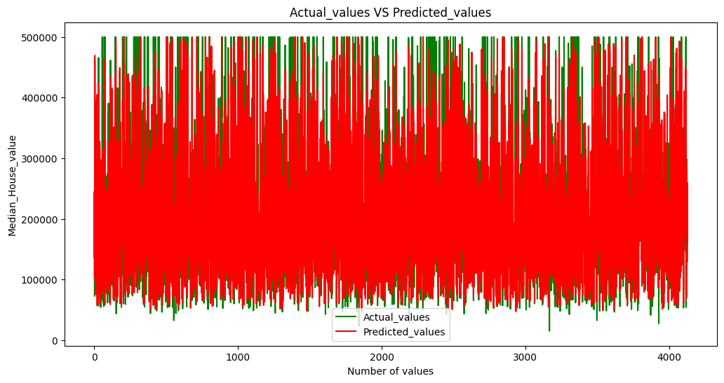
actual vs predicted prices
According to the histogram generated, the data used as the actual was almost as the prediction.

Slide 9
conclusions
The data used(Paris house pricing) has earned the objective of the project.
The predicted price lies close to the actual house pricing for different features
The Linear Regression model may be a slightly better fit for the data than the Random Forest Regression model.

Slide 10
Thank you

